Slide 1
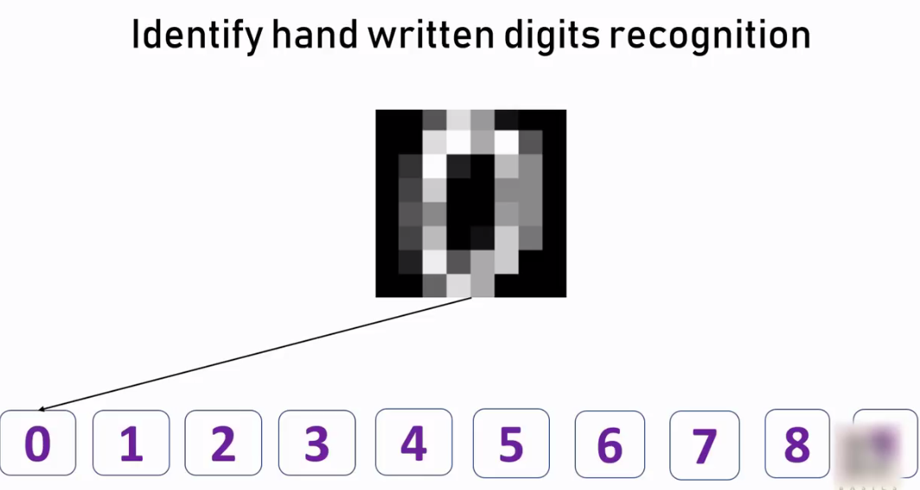
E05 :Write a program to implement Multi-class Classification. Logistic regression

Slide 2
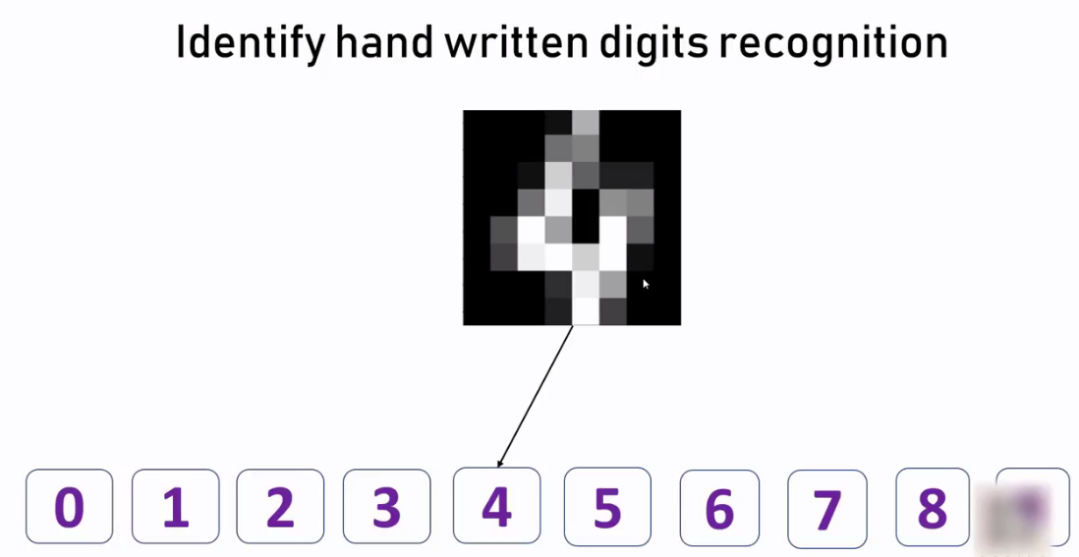
2

Slide 3
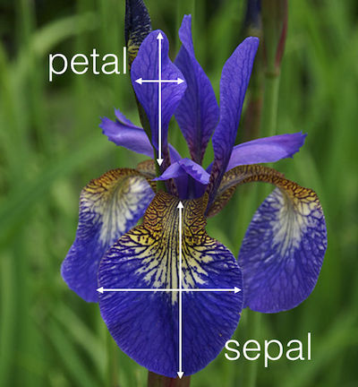
Exercise
Use sklearn.datasets iris flower dataset to train your model using logistic regression. You need to figure out accuracy of your model and use that to predict different samples in your test dataset. In iris dataset there are 150 samples containing following features,
1]Sepal Length
2]Sepal Width
3]Petal Length
4]Petal Width
2]Using above 4 features classify
a flower in one of the three categories,
1]Setosa
2]Versicolour
3]Virginica

Slide 4
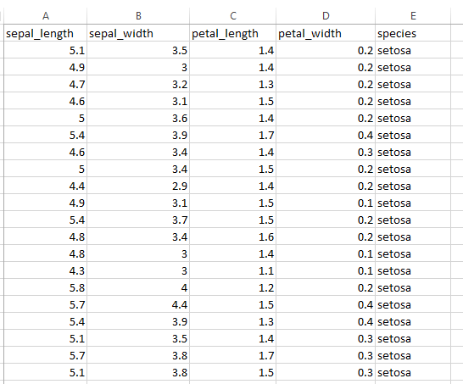
Iris dataset

